Slide 1



Module: 10-Minute Coaching

Slide 2


Intense
Timed
Tasters
Notes:
What is the main advantage of drinking espresso instead of americano? It takes less time.
These four sessions are like drinking shots of espresso.
First of all, it’s INTENSE. The content has been condensed from roughly four days into four small chunks to save busy managers’ time. Plus research shows that intense bursts of learning are just as effective as long training sessions.
The trade-off is that we will STRICTLY TIME all activities so that we can deliver the sessions in the short time allotted. Remember we will be learning just as much as if we spent all day discussing these frameworks and research.
The activities are meant to be TASTERS. If You only manage to go through three questions out of eight, that’s absolutely fine. The exercises will give You enough of a taster to get You started. It’s important to apply what You have learned right after the session, and we will support You.

Slide 3
Agenda for Today
Why Coaching?
A 10-Minute Coaching Conversation
Next Steps
Notes:
Today we’ll discuss what Coaching is and why it’s important.
Then I’ll walk You through a simple way of having a short but meaningful Coaching conversation.

Slide 4


Why Coaching?

Slide 5


Take a deep breath …
and reflect: what was the best Coach You’ve had?
What made him or her best?
Notes:
Ask the participants to share with the room and connect to the topic: great Coaching really helped us in our development. What is Coaching and how does it work?
First of all, let’s establish why Coaching is one of the most powerful leadership tools – what Coaching is and what it is not.

Slide 6


Feedback
Coaching
Past Behaviour
Future
Behaviour
Evaluate & Correct
Develop
Tell
Ask & Help
Find Own Way
FPM
Notes:
People are often confused about the definition of Coaching and how it differs from feedback.
While there may be some overlap, these are two very distinct methods of interaction.
There is a difference in FOCUS, PURPOSE, and MEANS.
The FOCUS of feedback is on past behaviour. The FOCUS of Coaching is on future behaviour.
The PURPOSE of feedback is to evaluate and correct. The PURPOSE of Coaching is to develop.
The MEANS of feedback is by telling. The MEANS of Coaching is by asking and helping a person to find their own way.
Both tools are important, and every leader needs to have both in their toolkit. We WILL discuss feedback in much more detail in one of our later modules..
It is also important to note that sometimes we use the term ‘coaching’ in a negative sense, i.e if someone is underperforming, we say “he needs Coaching”. However, Coaching is a very POSITIVE TOOL that can be used for people’s growth, development, and problem-solving in almost all situations. What we want to say very clearly here is: we believe that Coaching should be the PRINCIPLE TOOL of the manager and should be used much more frequently than corrective feedback.

Slide 7

Why ‘Telling’ doesn’t work very well
Prefrontal Cortex
Limbic System
Notes:
The reason is that constantly telling people what to do does not work. Here’s why.
Here is how the human brain works. Prefrontal cortex is a very important part of the brain that is responsible for making decisions, and yet is very energy-hungry, weak, and capricious.
It is very easy to upset it – if You expose Your brain to any physical threat, the fight-or-flight system of the brain (so-called limbic system) is activated. Brain resources flow in to support it, and as a result prefrontal cortex cannot function well, so we literally become dumb.
So here’s the key point: it seems that our brain cannot differentiate between PHYSICAL threat and SOCIAL threat.
When we tell people what they should do, they feel defensive. When people feel defensive, they don’t think straight.

Slide 8
our brain treats Social Threats in the same way as Physical ones
Status
am I more, less or as important as You are?
Certainty
do I know what will happen to me?
Autonomy
do I have a say or not?
Relatedness
are You my friend or foe?
Fairness
will You be fair to me?
David Rock, “Your Brain at Work” Doctorate in the Neuroscience of Leadership
Notes:
David Rock helpfully mapped out the five domains of social experience that create a threat response, using the acronym SCARF.
Our brain’s most important function is to keep its owner safe. So it constantly scans the environment, looking for potential threats.
(Explain each.)
Now, what happens if my boss is constantly telling me what I’m doing wrong and what I should be doing instead? Which elements of the SCARF are under threat? Most if not all of them (ESPECIALLY STATUS).
As a result, I feel ‘less than’, overwhelmed, and I can’t make rational decisions.
So, while telling people what they should do is sometimes important, it should not be our main way of managing people.

Slide 9
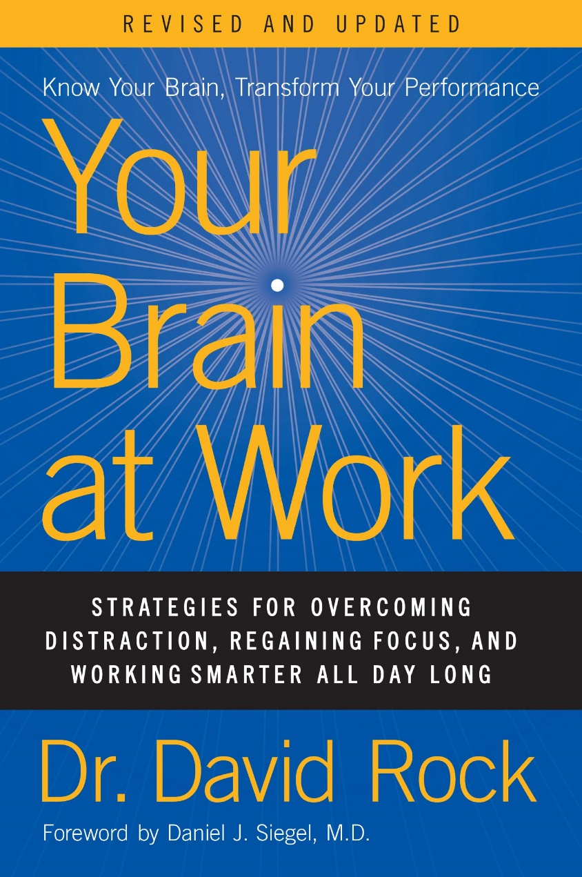
our brain treats Social Threats in the same way as Physical ones
Status
am I more, less or as important as You are?
Certainty
do I know what will happen to me?
Autonomy
do I have a say or not?
Relatedness
are You my friend or foe?
Fairness
will You be fair to me?
David Rock, “Your Brain at Work” Doctorate in the Neuroscience of Leadership
Notes:
David Rock helpfully mapped out the five domains of social experience that create a threat response, using the acronym SCARF.
Our brain’s most important function is to keep its owner safe. So it constantly scans the environment, looking for potential threats.
(Explain each.)
Now, what happens if my boss is constantly telling me what I’m doing wrong and what I should be doing instead? Which elements of the SCARF are under threat? Most if not all of them (ESPECIALLY STATUS).
As a result, I feel ‘less than’, overwhelmed, and I can’t make rational decisions.
So, while telling people what they should do is sometimes important, it should not be our main way of managing people.

Slide 10

constant telling also…
Creates Dependency
Inhibits Learning
Promotes Manager’s Burnout

Slide 11

time to recall

Slide 12

why Coaching is a better way to help people grow
it encourages people to
focus on the Solution
make their own Choices
find their own Answers
Notes:
So, why is Coaching a better way to change someone’s behaviour?
Why don’t we do it all the time then? (Listen to opinions.)

Slide 13
Coaching isn’t easy
Notes:
There are two main reasons for that.
First, it just takes a LOT MORE TIME than telling someone what to do.
Secondly, it creates A THREAT to our own brain.
Resisting the temptation to solve the person’s problem ourselves can be difficult. (Imagine watching someone struggle with a jigsaw puzzle, seeing where the missing piece is, but not being allowed to say anything).
Threat to Status – what if the other person comes up with a good idea and show that s/he is smarter than me?
Threat to Certainty – what if the other person can’t find a solution?
Coaching doesn’t come naturally to most people. But it is definitely worth the effort.
So, if You struggle with Coaching at the beginning, don’t give up!

Slide 14
Coaching isn’t easy
but it’s worth the effort
Notes:
There are two main reasons for that.
First, it just takes a LOT MORE TIME than telling someone what to do.
Secondly, it creates A THREAT to our own brain.
Resisting the temptation to solve the person’s problem ourselves can be difficult. (Imagine watching someone struggle with a jigsaw puzzle, seeing where the missing piece is, but not being allowed to say anything).
Threat to Status – what if the other person comes up with a good idea and show that s/he is smarter than me?
Threat to Certainty – what if the other person can’t find a solution?
Coaching doesn’t come naturally to most people. But it is definitely worth the effort.
So, if You struggle with Coaching at the beginning, don’t give up!

Slide 15

a 10-minute
Coaching Conversation
Notes:
So, Coaching should be a manager’s staple tool.
Unfortunately, it’s impossible to train someone to be a Coach in one hour.
The International Coaching Federation, for example, requires 60 hours of training and 100 hours of Coaching practice just to get the Associate Coach Certification. To get their Professional Certification, You need 125 hours of training and over 500 hours of practice.
We’d like to provide You with a very simple yet powerful framework for having short Coaching conversations with Your people. In the next hour we’ll give You enough to go ahead and start practicing.

Slide 16
8
THE
QUESTIONS
YOU NEED
Notes:
Remember how we talked about the fact that many people try Coaching, but when they realise how hard it is, give up altogether?
The main idea behind this model is that there are a few key questions You need for everyday Coaching conversations.
Instead of having formal meetings, You can just weave them into Your usual conversations with employees. You can do it at the coffee machine or when You stop by an employee’s desk for a chat.
The questions are easy to learn but very powerful.
Let’s go through the 8 questions and of course, have a couple of rounds of practice.
Some IMPORTANT CLARIFICATIONS:
Use other questions, too. By no means is this a comprehensive list.
Use other Coaching techniques. (Ask: can You tell me what they are?): reflective listening, paraphrasing, prompting.
The questions can be used in any order.

Slide 17
What
What
What
What
What
What
What
What
help to explore the issue/s
encourage
Intelligent
action
help them learn from this conversation
Notes:
Let’s summarise where we are so far. We’ve covered three questions that help the Coachee to explore their issue. The next five questions are going to be about encouraging them to take intelligent action.

Slide 18

what’s on Your Mind?
v
cuts through small talk
releases the brain load
supports Autonomy
What’s ON YOUR MIND?
Notes:
The great thing about this question is it cuts through small talk and helps start a meaningful dialogue quickly.
You know how sometimes we get stuck in small talk? We can go on for ages, not knowing how to jump in with a real topic.
This question also releases the brain load – if something worries a Coachee, we give them a chance to express it which brings relief.
It also gives Your employee the responsibility to choose what’s relevant to THEM.

Slide 19
what is Your main concern?
v
helps to prioritise and focus
invites deeper thinking
What is Your MAIN concern?
Notes:
This question implies there might be several challenges the Coachee is facing. They may feel overwhelmed by them. This questions helps the Coachee to prioritise and focus on the main issue they are dealing with.
It also forces them to think deeper about the issue. What is it about the issue that’s the MOST concerning?

Slide 20
what do You want to achieve here?
v
gives permission to express
what he or she actually wants
“An adult-to-adult relationship is one in which You are able to ask for what You want, knowing that the answer may be 'No’.”
Peter Block, an American author, consultant, and speaker in the areas of organization development
What do YOU want to achieve here?
Notes:
This question gives a Coachee permission to say what they ACTUALLY WANT.
(Back to SCARF) It builds Status and Autonomy.
This is a really important question. I like this quote from Peter Block (read)
Giving people permission to say openly what they actually want is much better than communicating in childish ways.
Another version of this question is, “What do You REALLY want to achieve here? What is Your ideal outcome?”

Slide 21

better than…
hinting
making sarcastic comments
demanding
resenting in silence
complaining to others
Notes:
Saying openly what You want – and giving Your people permission to do so – is a very effective way of communication. It is much better than other ways that people often use when they are afraid to speak up: hinting, making sarcastic comments, demanding, resenting in silence or complaining to others. In other words, if You don’t give them permission to speak openly, they will still communicate back – but in less helpful ways!

Slide 22
What’s ON YOUR MIND?
What is Your MAIN CONCERN?
What do YOU want to achieve here?
What
What
What
What
What
help to explore the issue/s
encourage
Intelligent
action
help them learn from this conversation
Notes:
Let’s summarise where we are so far. We’ve covered three questions that help the Coachee to explore their issue. The next five questions are going to be about encouraging them to take intelligent action.

Slide 23
what is Your next step?
v
focuses on the action
emphasises immediacy
What is Your NEXT STEP?
Notes:
There are FIVE more questions to go! Those will be focused on taking the action, and on learning from this Coaching conversation.
Once you’ve helped the person to understand the issue and what it is they really want, it’s time to move them to action.
This question is particularly good because it not only focuses them on the action, it also emphasises immediacy. What is it that You can do next? We are no longer talking in abstract, let’s focus on what You can do straight away.

Slide 24
what else could You do?
v
first idea is rarely the best
What ELSE
could You do?
Notes:
“And what else?” – this is probably best Coaching question ever.
First of all, a person’s first answer is rarely the best – so You need to dig deeper. What else can You do?
Let’s look at why it’s important to expand the coachee’s pool of options.

Slide 25

2 options
52%
failed
“How can I make it work?”
3
options
32%
failed
“Is there a better way?
Source: Paul Nutt, Professor of Management Sciences, The Identification of Solution Ideas during Organizational Decision Making, Management Science.
Notes:
Researcher Paul Nutt studied outcomes of major decisions made by large organisations (if anyone asks - 168 organisations). And he made a couple of interesting discoveries.
First, he found that in the majority of the cases the choice was A BINARY ONE, in other words, having only two options (“whether or not” type decisions).
Interestingly, teenagers also make about the majority of their decisions from a binary perspective. “Do I look cool and drink that beer, or do I look lame and not drink one?” It doesn’t occur to them that there is a THIRD option – You can look cool without having to drink. With teenagers, this is understandable – their brains are not fully developed yet.
But what is understandable with teenagers, is less forgivable with organisations. And Paul Nutt found that when organisations made binary choices, the outcomes of their decisions failed 52% of cases! The coin flip does better.
However, when they considered just one more option, the failure rate dropped to 32%.
The reason behind it that introducing three viable options instead of two changes our mindset about making decisions. It is a different way of thinking. When we think in a “whether or not” way, the real question we are asking ourselves is “How can I make it work?”. In other words, we already made our decision, we are just trying to push our desired outcome. However, when we introduce three viable options, we are asking a much better question: “Is there a BETTER way? What else could we do?”
So expanding the coachee’s options and broadening their thinking about an issue is really important.

Slide 26
what else could You do?
v
first idea is rarely the best
considering more options leads to better decisions
a great add-on question
What ELSE
could You do?
Notes:
Finally, this is a great add-on question. You can use it throughout the Coaching conversation.
For example: What else do You find challenging? What else can You do?

Slide 27





“I like it”
“yes”
“brilliant”
“nice”
“good one”
Notes:
By the way, don’t forget to continue showing affirmation, even if their first idea isn’t great. Show affirmation, and then keep asking “What else could You do?”

Slide 28
what do You need to stop doing?
v
“The essence of strategy is choosing what not to do” Michael Porter, Professor at Harvard Business School
What do You need to STOP doing?
Notes:
Once the person starts thinking about action, it’s really important to help them prioritise. If they decide to do X, is there anything they need to stop doing as well? This could refer to both behaviour (i.e behaviour that is not working) and workload (e.g. I need to stop doing too many things).
Another way of asking this question is, “If You say yes to this, what are You saying no to?”

Slide 29



why we say yes far too often
being a victim
people-pleasing
being over-optimistic
Notes:
By the way, for some of us a real barrier to productivity is inability to say ‘no’.
There are three main reasons we do this:
Feeling like a victim - You feel You have no choice but to say yes.
Being a people-pleaser - You need everyone to be happy with You.
Or the planning fallacy - being overly optimistic. Most of us are really bad at estimating how much time it takes to do something. We say “yes” without thinking and then have to fight fires because of the overload. As a result, something suffers – our effectiveness at work, our sleep, health, or family life.

Slide 30
how to say yes more…slowly
When You say it’s urgent, what do You mean?
What do You want me to take off my plate so I can focus on this?
If I couldn’t do all of this, what part would You have me do?
Can I think about it and come back to You tomorrow?
Notes:
For some of us, dealing with these issues fully requires a help from a professional Coach or even a counsellor and is beyond the scope or our 10-minute session.
But here are a few handy tips You can start using today.
Instead of saying “yes” immediately, pause and ask a question instead (read the four questions on the slide).

Slide 31
what do You need to stop doing?
v
supports Autonomy – invites choice
What do You need to STOP doing?
builds Status – encourages responsibility for actions
and consequences
Notes:
So, this question helps the Coachee in two ways.
First, it supports their Autonomy – You are giving them choice to sometimes say no, thereby giving them more freedom to make their own choice. And that may mean that sometimes they will say no to You!
But by doing that, You are also building their Status – You are treating them like an adult who takes responsibility for their actions.

Slide 32
what do You need from me?
v
Being overly helpful can be bad.
You don’t have to say “yes” to what the Coachee asks of You in response to this question. You could say no, or:
“Let me think about it.”
“Can’t do X but can do Y.”
What do You need FROM ME?
Notes:
This questions is important, but it should be asked at the end of Your conversation. What will happen if You lead with that question (ask the audience)?
Being overly helpful can be counterproductive. Because You diminish that person’s Status and Autonomy. You might end up doing all the work for Your Coachee, instead of helping them to find a solution.
By using this question at the END of the conversation, we offer help in a measured way.
At the same time, do not be afraid to offer help. Remember, that by asking this question You do not automatically have to agree to do everything they ask You for.

Slide 33
what was most useful to You?
v
reinforces learning
ensures mutual understanding
creates a good impression of YOU
What was most USEFUL to You?
Notes:
Finally, there is a learning question we can use to end our conversations. It can help in three ways:
First, repetition reinforces learning.
Secondly, it tells whether You and the Coachee are aligned on the outcomes of the conversation. How many times have You had a conversation with someone thinking that You both agreed on a certain outcome, only to find out later that You did not?
Finally, this question creates a good impression of You. If Your conversation was helpful to them, they will now associate You with the feeling of being helped!

Slide 34
What’s ON YOUR MIND?
What is Your MAIN concern?
What do YOU want to achieve here?
What is Your NEXT STEP?
What ELSE could You do?
What do You need to STOP doing?
What do You need from ME?
What was most USEFUL to You?
help to explore the issue/s
encourage
Intelligent
action
help them learn from this conversation
Notes:
Let’s summarise where we are so far. We’ve covered three questions that help the Coachee to explore their issue. The next five questions are going to be about encouraging them to take intelligent action.

Slide 35
Closing Comments

